Slide 1

M4 - Video Analysis
Block 2. Background estimation.
Adrià Ciurana
Guim Perarnau
Pau Riba

Slide 2
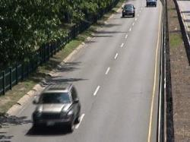

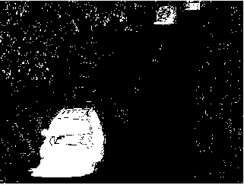
Week 1: Change groundtruth interpretation
Original image
Ground truth
Segmentation
RGB image
Grayscale image
Binary image
0 → static 50 → hard shadow
85 → outside ROI 70 → unknown motion
255 → motion
Ground-truth AND Segmentation = TP
Ground-truth AND ¬Segmentation = FP
¬Ground-truth AND ¬Segmentation = TN
¬Ground-truth AND Segmentation = FN
Background
Foreground
Unknown
(¬ = negation)

Slide 3
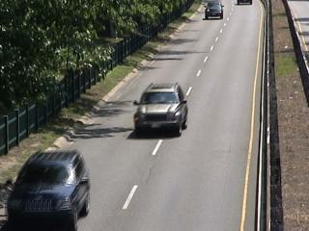
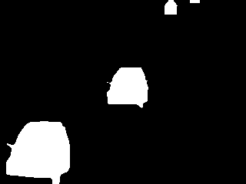

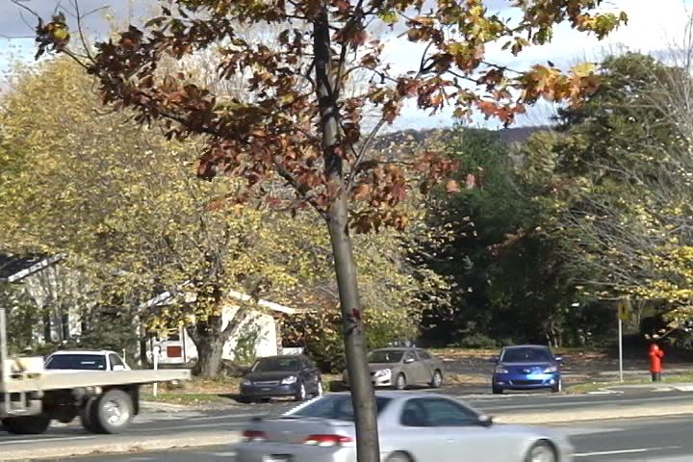

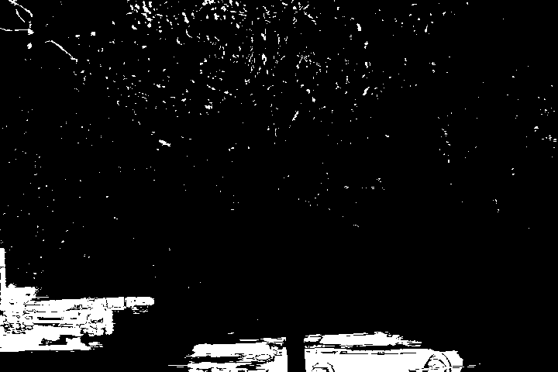
Task 1: Non-recursive Gaussian modeling
Highway: in001200
Original image
Ground truth
Segmentation
Fall: in001532
Original image
Ground truth
Segmentation

Slide 4
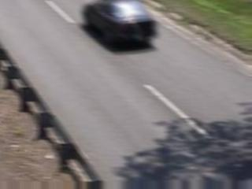


Task 1: Non-recursive Gaussian modeling
Traffic: in001037
Original image
Ground truth
Segmentation
Comments:
In the fall sequence we can see that the segmentation fails when it comes to dynamic background, more concretely, to tree leaves that are continually moving.
In the highway sequence this also happens, but to a minor degree. Also, it occurs that one of the cars is bad segmented for what we think is caused by the color similarity between the car and the road (background).
Finally, in the traffic sequence we have jitter, which increases the pixel variance, specially in non homogeneous regions (such as the bottom left zone). This negatively affects our model, and therefore, our segmentation.

Slide 5
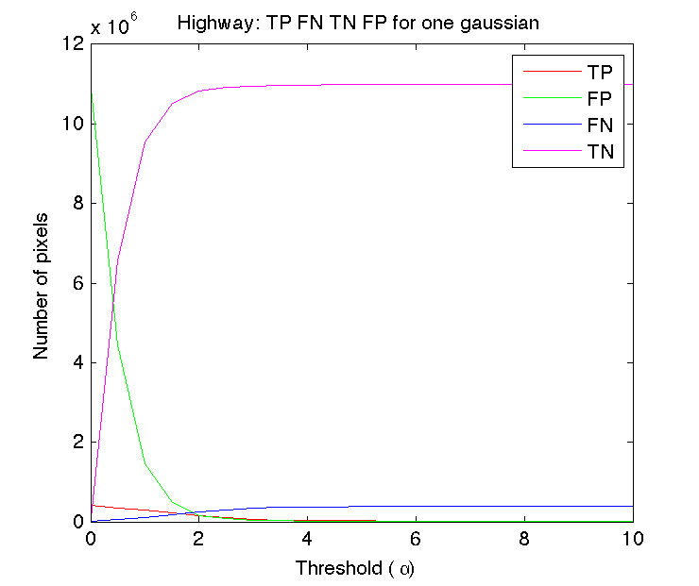
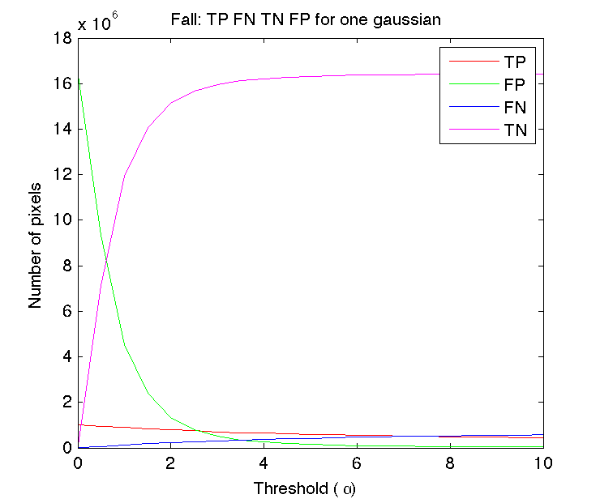
Task 2: Results Evaluation
Note: TP → foreground detected as foreground TN → background detected as background
The frames are in grayscale.

Slide 6
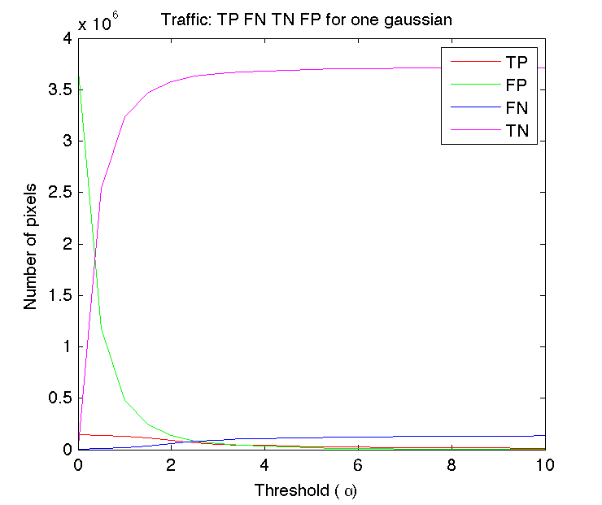
Task 2: Results Evaluation
The three sequences (fall, highway, traffic) have the same behaviour in terms of TP, FN, TN and FP.
Low ɑ → less background and more foreground is detected. Hence, both TP and FP increase whereas FN and TN decrease (meaning a high recall).
High ɑ → more background and less foreground is detected. Thus, FN and TN increase whereas TP and FP decrease (meaning a high precision).
Note: TP → foreground detected as foreground TN → background detected as background.
The frames are in grayscale.
Notes:
Quant més gran és alpha, MENYS foreground detectes. Per tant, els TP haurien de disminuir i els FN augmentar. Que és justament el que està passant.
Si t’ho mires des del background, quant més gran és alpha, MÉS background detectes. Per tant, els TN haurien de pujar, i els FP haurien de baixar.

Slide 7
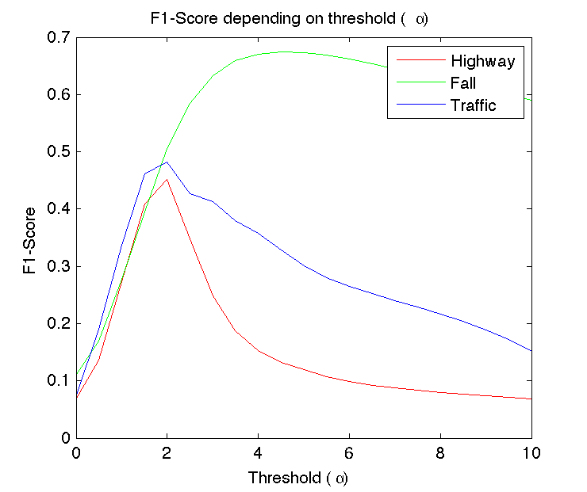
Task 2: Results Evaluation
What happens?
Sequence | Alpha | F1-score
Highway | 2.0 | 0.4517
Fall | 4.5 | 0.6741
Traffic | 2.0 | 0.4826
The F1-Score drop in Highway and Traffic is caused by two reasons:
In both sequences there is stationary background, meaning that a higher alpha - which is suitable for high variances (dynamic backgrounds) - incorrectly detects moving cars as background. However, in Fall the F1-Score improves with a higher alpha because it has a non-stationary background.
The alpha value becomes too restrictive, hence, the TP for these sequences decrease abruptly.
Notes:
Per què a partir de alpha = 2.5 el F1-Score del highway i traffic decreix, mentre que el de fall segueix augmentant substancialment?
Fall sequence gets the best F1-Score. The point of view of the camera can help because the cars to detect are correctly identified against the background.
For sequences Highway and Traffic the cars to detect can be easily confused with background due to its color similarity.

Slide 8
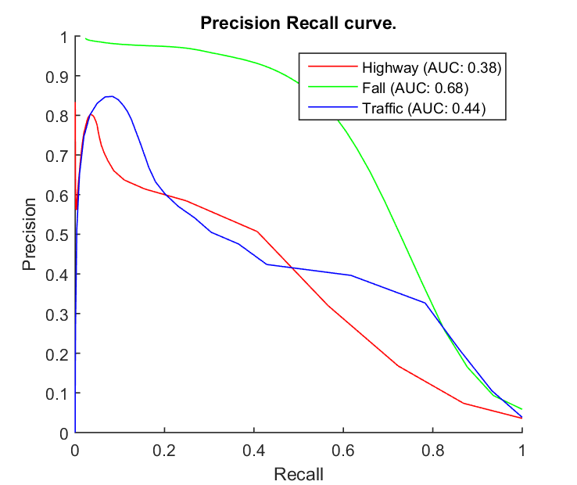
Task 3: Precision vs Recall
The same behaviour as the previous plot (F1-Score) can be seen. The sequence that has the best AUC is Fall. The reasons are the same as the ones mentioned at the previous slide.

Slide 9
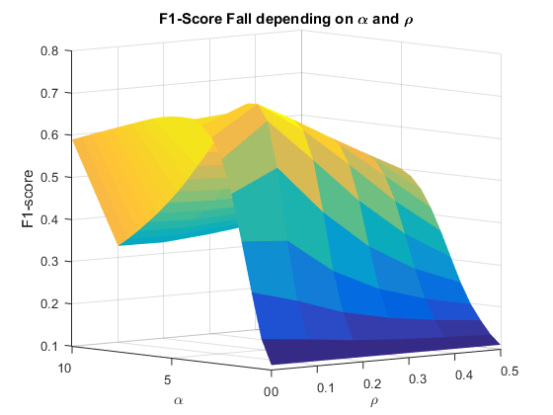
Task 4: Recursive Gaussian modeling
Two different approaches:
Fixed ɑ using the first approach, find best ⍴.
Optimize ɑ and ⍴ together.
We have chosen the later because we can achieve a better F1-Score.
These are the results:
Note: grayscale frames.
We can observe that the optimal ɑ does not correspond to the same computed in Task 2. Thus, ɑ and ⍴ are dependent.
Sequence | Alpha (ɑ) | Rho (⍴) | F1-Score
Highway | 3 | 0.2 | 0.7284
Fall | 3 | 0.1 | 0.7038
Traffic | 4 | 0.2 | 0.6796

Slide 10
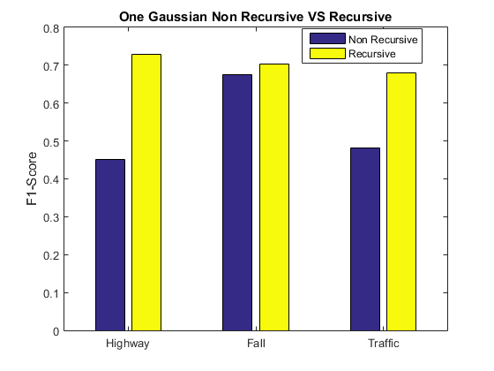
Task 5: Evaluation and comparison
The F1-Score has considerably improved compared to the first approach for all the sequences but Fall.
Now, the best metric is obtained for the Highway sequence as it is expected (baseline).
Therefore, adaptative learning has proven to generally enhance the F1-Score for our sequences because the algorithm takes into account more information dynamically and not only the first 50% half of the sequence.

Slide 11
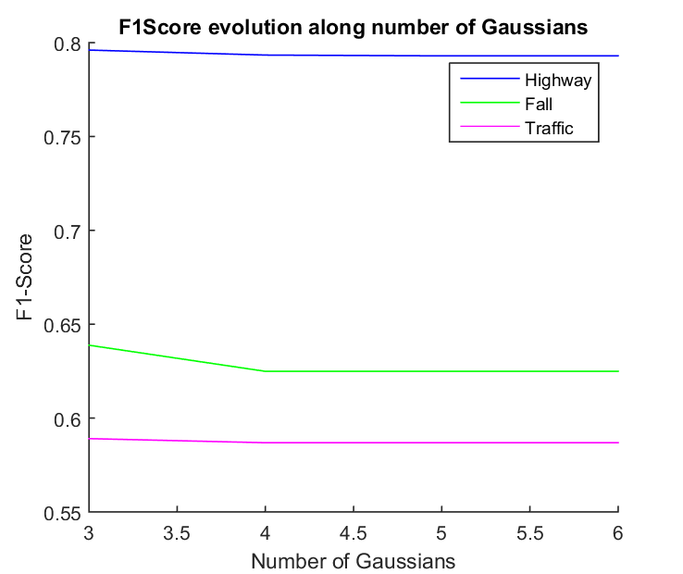
Task 6: Stauffer and Grimson
Train the model with 50% of the sequence (same conditions as our single gaussian distribution approach).
Call vision.ForegroundDetector MATLAB object.
Find optimal number of Gaussians (3 to 6).
(Optional) Tune the other parameters, too.
For Fall sequence, 3 Gaussians are clearly the optimum number. For Fall and Traffic sequences changing the number of Gaussians do not considerably affects the F1-Score, but still, 3 Gaussians give a slightly better F1-Score.

Slide 12
Task 6: Stauffer and Grimson
The optimal number of Gaussians depends on the type of video. A lower number is preferred for static background. On the other hand, more Gaussians are suitable for non-stationary backgrounds, such as rustling leaves or jittering cameras. We think that this is the reason why the F1-Score does not drop when increasing the number of Gaussians with Traffic (dynamic background) and Fall (jittering) sequences. The highway sequence, however, is mostly a static background, making the addition of more than 3 Gaussians to be counterproductive.

Slide 13
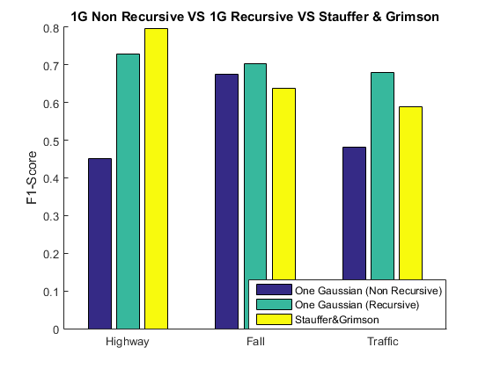
Task 6: Stauffer and Grimson
We expected the Fall sequence to be the most benefited by S&G because of its dynamic background. However, and after optimizing S&G parameters, we have only achieved to considerably improve the F1-Score of Highway and Traffic sequence.
Sequence | Gaussians | Learning Rate | Background Ratio | F1-Score
Highway | 3 | 0.008 | 0.5 | 0.7960
Fall | 3 | 0.012 | 0.8 | 0.6388
Traffic | 3 | 0.016 | 0.7 | 0.5890
Notes:
Precision - recall,

Slide 14
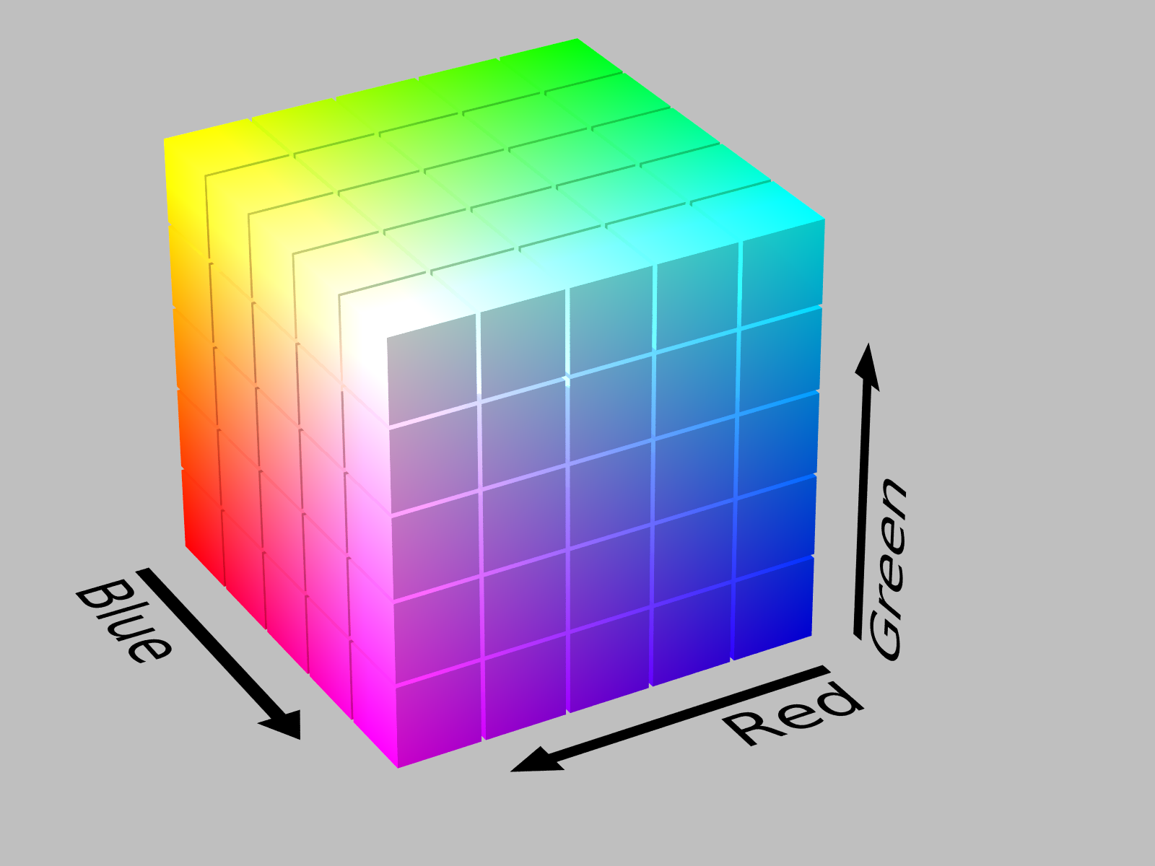
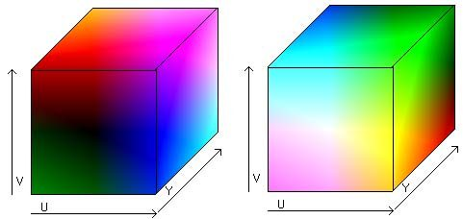
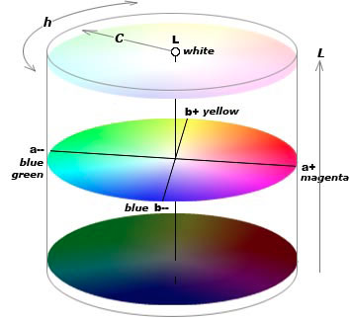
Task 7: Color sequences
Color space? Three color spaces have been tested.
Number of Gaussians? 3, one for each channel.
Methodology (one Gaussian):
If a 3D color pixel falls outside the 3D Gaussian (given a ɑ threshold), it will be considered as foreground. Otherwise, it is labeled as background.
RGB
YUV
CIE Lab
Notes:
Methodology:
Apply the previous techniques for all the channels.
OR operation between channels.

Slide 15
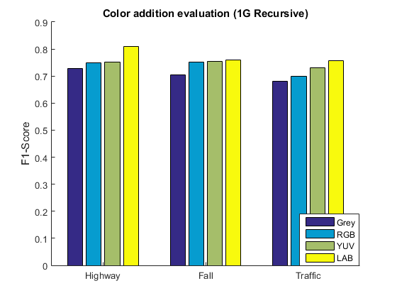
Task 7: Color sequences
The extra information given by the color improves the previous background estimation, being LAB color space the best among the ones tested.

